Slide 1
Thank you for joining
Committee will be here in the next 10 minutes
Please mute yourself when the presentation starts

Slide 2
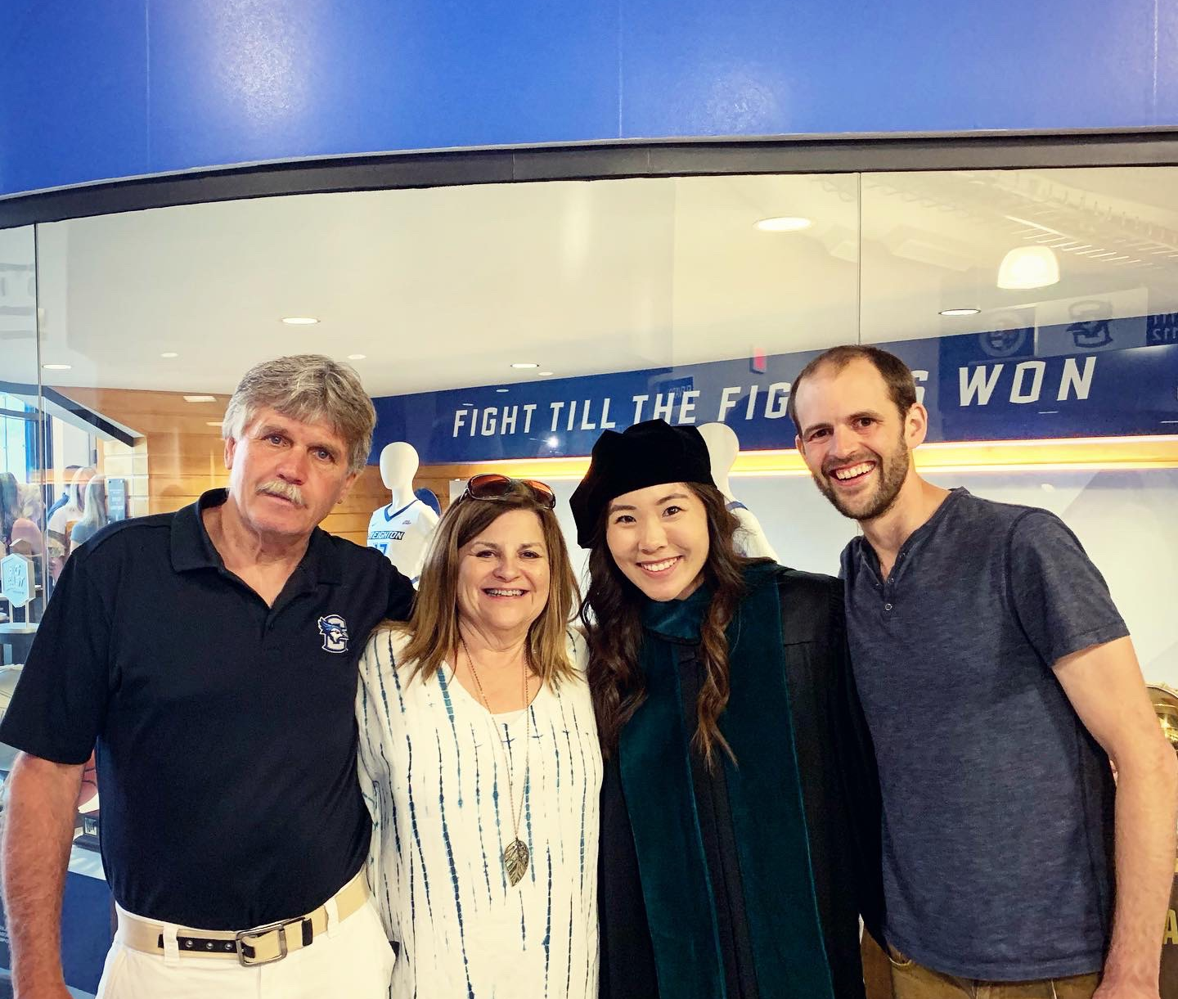
Mom, Dad, and Sister
Notes:
Before I get started with my defense, I want to talk about the people who got me here. You can’t see them all, but my family is here, my mom, dad, and my sister Alex. This is Alex getting her doctorate before I did even though I had a head start. Anyway, they’ve been hugely supportive throughout my endless years of schooling, and for that I’m so grateful. I can't possibly explain how much it means to me that I get to share this with you guys. I’m dedicating a lot of this to you guys and I love you!

Slide 3
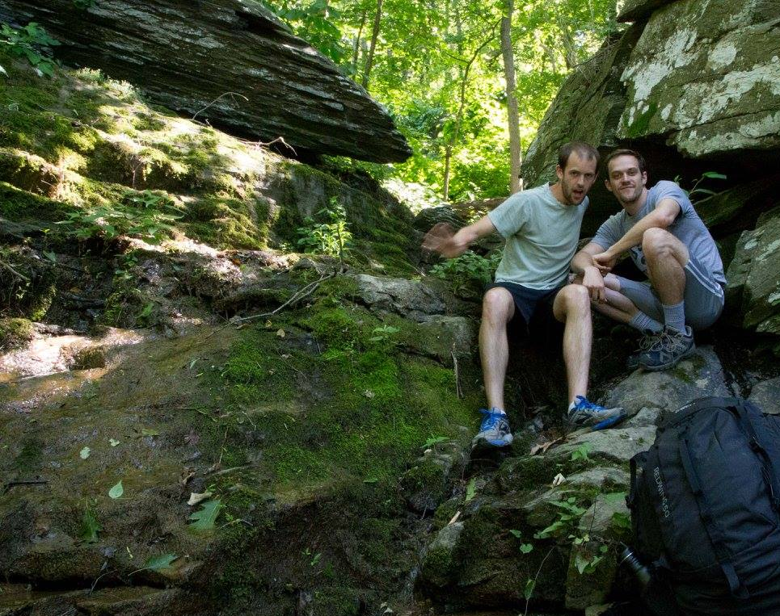
Mark
Notes:
I’m also dedicating this thing to my good friend Mark. Mark and met and college and applied to psychology PhD programs at the same time. I can’t do justice here to all the ways you’ve supported me along the way buddy. But, to say the least, Mark helped me through years of applying and getting rejected from graduate school, and he was the first person I called when I was accepted at Michigan. Here’s us taking a break along the Appalachian trail in Pennsylvania. It’s been a journey buddy!

Slide 4

Kelly
Notes:
Finally, I’m dedicating my dissertation to Kelly, the love of my life. I can’t do justice to everything things she’s done for me here, but Kelly’s been by my side through my dissertation but also through my transition from Psychology to Data Science. She’s teaching General Psychology at CU Boulder upstairs right now, but if she were watching I’d tell her I love her and I thank you for pulling me away from Python and R consoles to get my dissertation done!

Slide 5
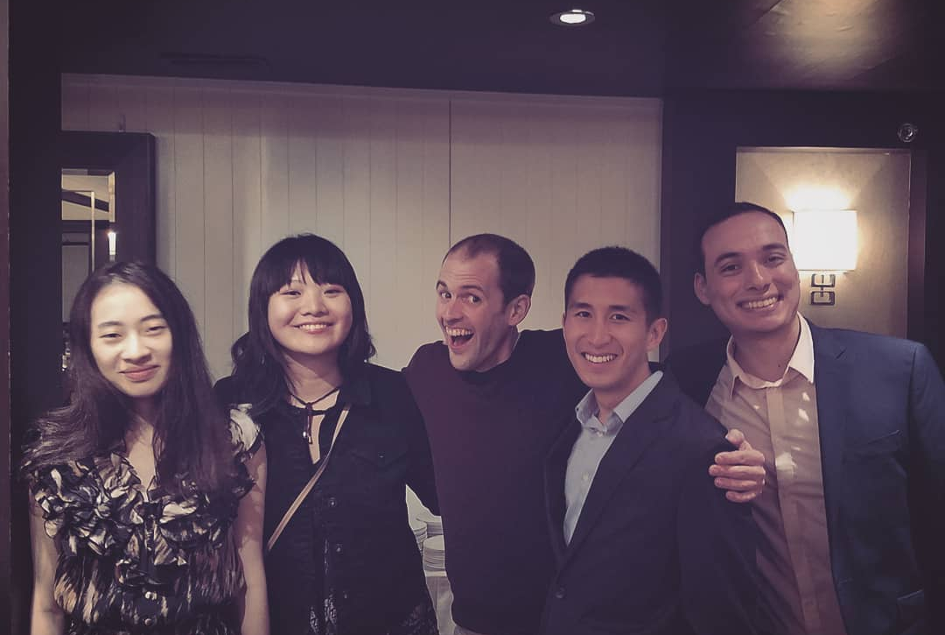
Cohort
Notes:
Of course, I have to thank my cohort for years of support and good memories, from late night stats discussions and too many whiskeys to berry picking and data science fellowships. Thanks for everything, guys!

Slide 6

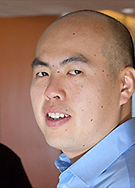
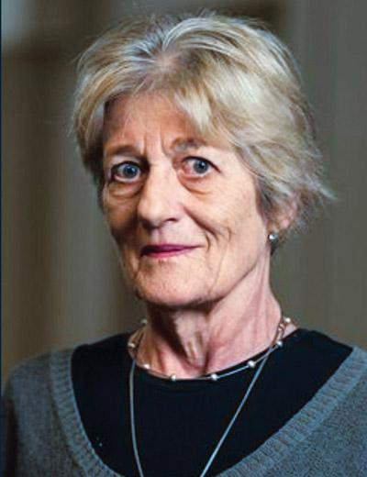


Dissertation Committee
Notes:
And last, I’m thanking my committee who didn’t just read my 100-plus-page dissertation and agree to criticize me publicly but also for supporting me, inspiring me, and making sure I get something done. Just to be clear, just because this group of people are rockstars has really nothing to do with how good any of my work is. I’m really just showing them off to brag a little. I’ll get a chance later to thank each of them later, but I want to take a second to acknowledge and thank Josh. For five years, Josh has been supportive, kind, and generous with his time and resources. Josh kept me humming along while presumably he juggled about a thousand different things. I have so many opportuntieis in front of me know because you took a chance on me and because you got me through this. Thank you.

Slide 7

Ask questions if something doesn’t make sense
Notes:
OK, now you have to forget everything I just said and make me defend this thing. To start, unless you’re on my committee, please limit your questions to clarifying questions.

Slide 8
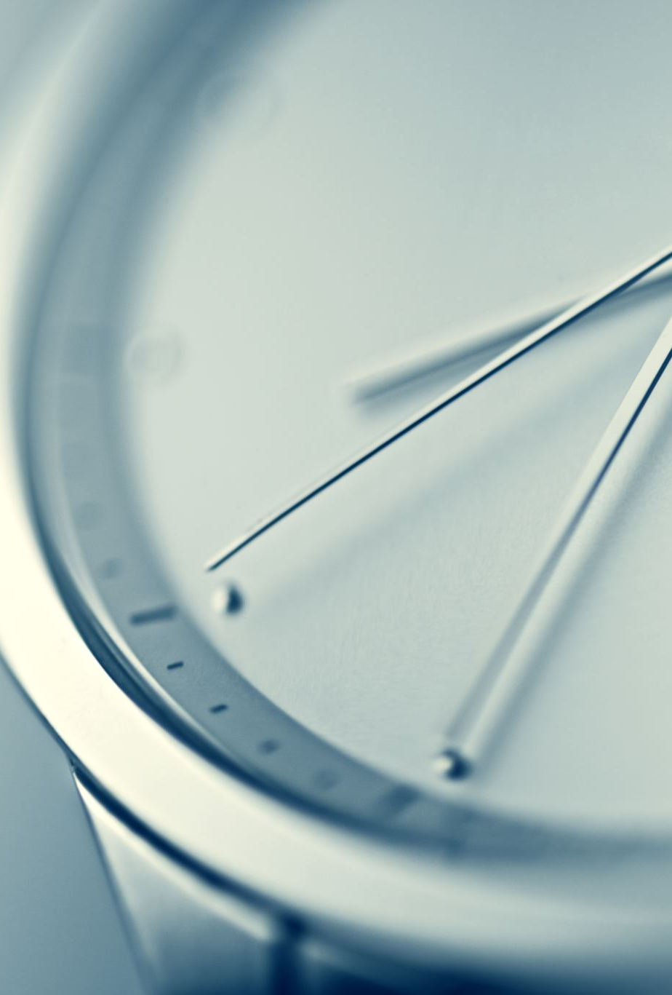
Outline
How long will the whole thing take?
30-45 minutes
Chapter 1. Behavioral Immune System
More minutes
Chapter 2. Differences in infection cue strength
Fewer minutes
Chapter 3. Mental representations of infected others
More minutes
Notes:
I want to give you a sense of time. This should take 30-45 minutes. The first chapter is longer than the others.

Slide 9
(Mis)perceiving infection
Nick Michalak
Notes:
Now I’ll get started. As most of you know, for the past 5 years I’ve studied how people perceive infectious disease. So you shouldn’t be surprised if I start off with a story about oysters.

Slide 10


Oysters open and close their valves with the tide
Notes:
If you didn’t know, oyster behavior is pretty simple: when the ocean tide is high, they open their valves to siphon plankton and when the tide is low they close them so they don't dry out.

Slide 11


How do oysters know when the tide changes?
Brown, 1954; Schaller & Neuberg, 2012
Notes:
In the 1950s the biologist Frank Brown was interested in how they do this. How did they “know” when the tide changes? So he scooped up a batch of them from Connecticut and brought them back to his lab in Chicago.

Slide 12
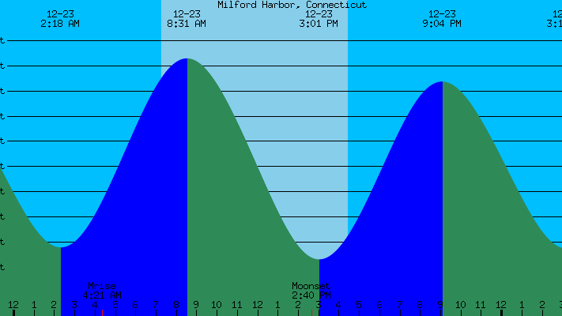
Oysters opened and closed with the Connecticut tide … but then they changed their patterns?
Notes:
For the first two weeks, the oysters continued to open and shut their valves in-sync with the tides of Connecticut, but after three weeks something crazy happened: Their cycles shifted.
This was really weird at the time because no one could figure out which tidal pattern the oysters has synced with.

Slide 13
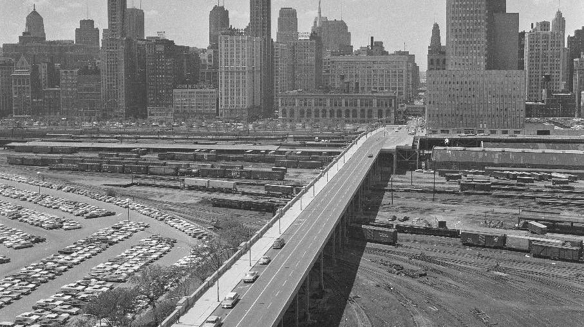
They synced with the … Chicago tide?
Notes:
But then they figured it out: The oysters were syncing up with the “tide” in Chicago. But if you've ever been to Chicago or looked at a map, you know that Chicago doesn't have an ocean. So what was going on?

Slide 14
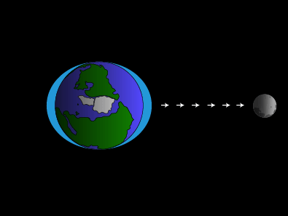
Low Tide
High Tide
Moon
Low Tide
Oysters are sensitive to subtle shifts in the gravitational pull of the moon
Notes:
Oysters can't look out the window to see when the tides change; instead their physiology is sensitive to subtle shifts in the gravitational pull of the moon.
This is because oysters evolved in environment in which it was efficient to calibrate their valve behavior to the lunar cycle. Gravitational shifts were a reliable cue to high tide. To oysters, high tide looks like subtle changes in gravity.

Slide 15
What do oyster behavior and tidal patterns have to do with infectious disease?
Notes:
What does this have to do with infectious disease?

Slide 16
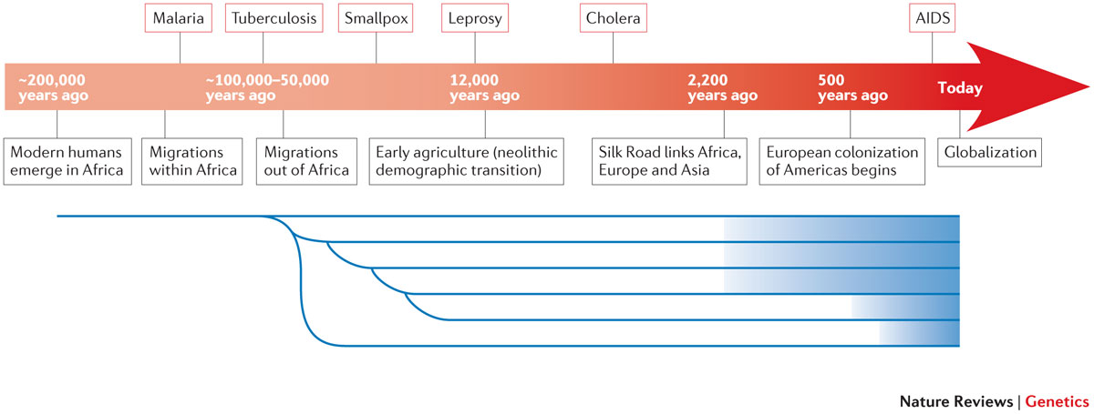
Infectious disease is like the tide: It’s an enduring, predictable feature of the environment
Notes:
Well, like the tide, infectious disease is an enduring, predictable feature of the environment.
https://www.ncbi.nlm.nih.gov/pmc/articles/PMC4912034/#MOESM1

Slide 17
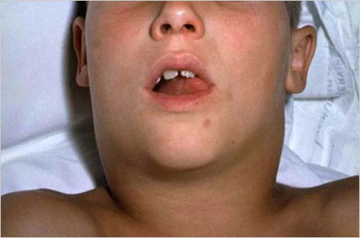
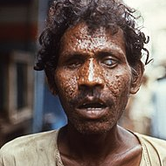
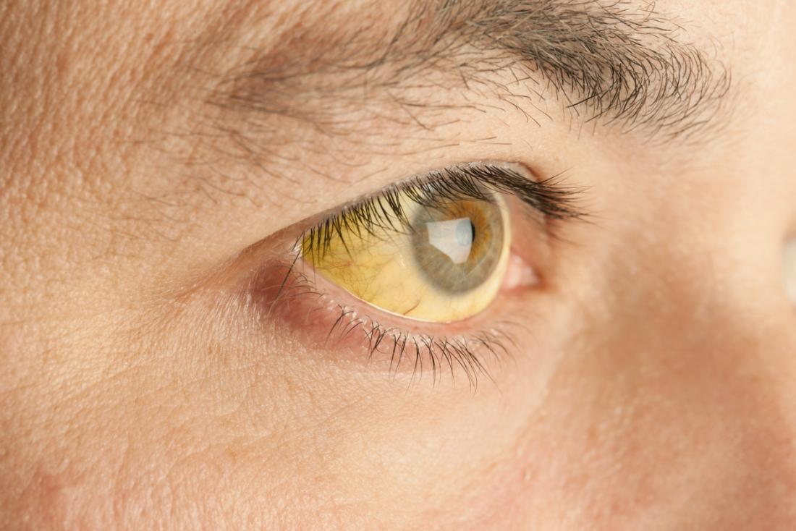
Humans exploit cues in their environment to detect infectious disease in others
Diphtheria
Smallpox
Yellow Fever
Notes:
And, like oysters exploit cues in their environment to predict the changing tide, humans exploit cues in their environment to detect infectious disease in others. Put differently, humans perceive infection indirectly through cues.

Slide 18
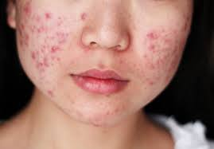
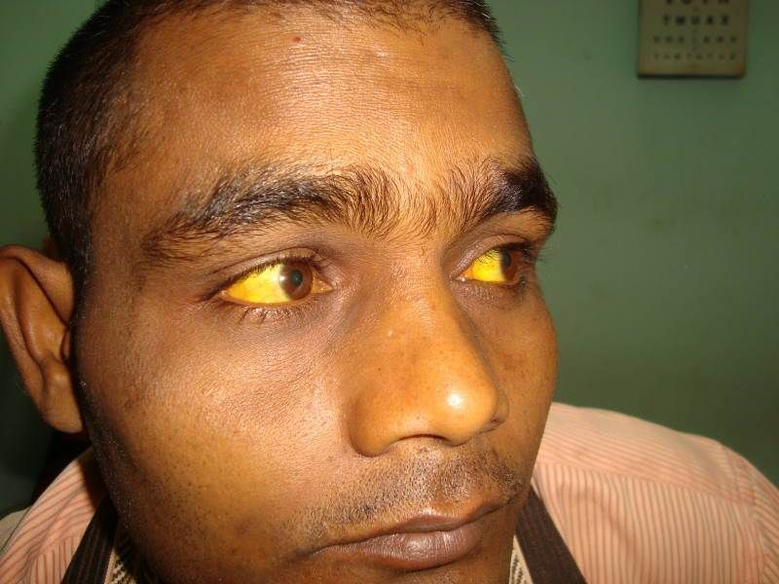
People are prone to misperceive infection in objectively benign cues
Acne
Acute liver failure
Obesity
Notes:
And because cues are only imperfect indicators of infection, people are prone to misperceive infection in objectively benign cues. So, like oysters misperceive the tide changing in Chicago, people misperceive infection in cues that resemble true symptoms of infection.

Slide 19
Completely understanding social psychology requires proximate and evolutionary explanations
Proximate Explanations
Explain how organisms work in terms of structure, mechanism, and development
Evolutionary Explanations
Explain why organisms work they way they do in terms of environmental selection pressures and ancestral organisms
Notes:
I won’t talk about oysters anymore. But, as I talk about how people perceive and misperceive infection, I want you to keep our evolutionary environment in mind. Completely understanding how the mind works often requires that we consider the environmental pressures that the mind evolved under. Most of us are used to explaining psychology and behavior in terms of proximate explanations. That is, how do organisms work in terms of structure, mechanism, and development. But proximate explanations don’t explain everything. They complement evolutionary explanations, which explain why organisms work the way they do in terms of environmental selection pressures and ancestral organisms.

Slide 20

Why do oysters open and close their valves with the tide?
Proximate Explanation
Because of changes in the gravitational pull of the moon
Evolutionary Explanation
Because oysters with open valves dry out during high-tide, making it difficult to successfully reproduce
Notes:
For example—I lied about the oysters—why do oysters open and close their valves with the tide? A proximal, mechanistic explanation would be that they do this because of changes in the gravitational pull of the moon. A complimentary, evolutionary explanation would be that they do so because their oyster ancestors synced up their valve behavior with the tide so they were less likely to dry out during low tide, more likely to eat up yummy plankton during high tide, and more likely to successfully reproduce. Both these explanations help us better understand oyster behavior.

Slide 21
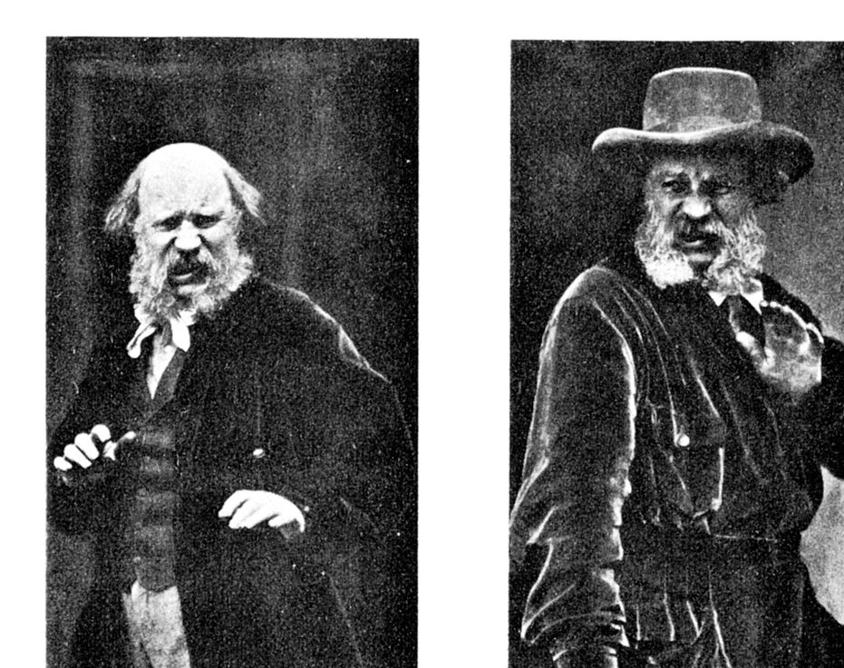
Why and how do people (mis)perceive infection in others?
Notes:
Now that’ll you’re all oyster experts I can finally talk to you about human pathogen avoidance psychology.

Slide 22
Here’s how the rest of my talk looks
Chapter 1. The behavioral immune system
1
Chapter 2. Differences in infection cue strength
2
Chapter 3. Mental representations of infected others
3
Notes:
To give a sense of how what to expect, the rest of my presentation has three parts, one part per chapter of my dissertation. In chapter one, I’ll introduce you to the behavioral immune system hypothesis and review some of its empirical support. This first chapter serves as a foundation for chapters two and three. In chapter two, I’ll review the hypothesis that the behavioral immune system evolved to process infectious disease cues which enables it to process perceptually similar but benign cues. And then I’ll summarize some studies I ran to test the hypothesis that some cues are more strongly associated with infection than other cues. Next, in chapter three, I’ll talk about why we might expect people to have a unique mental representation of infected others, and then I’ll summarize some studies I ran to estimate these kinds of mental representations. Finally, I’ll conclude with some takeaways.

Slide 23
Infectious disease has imposed an immense selection pressure on human life for millions of years
Estimates suggest infectious diseases have killed more people than all other causes combined
Inhorn & Brown, 1990
Notes:
The specter of disease caused by infectious pathogens has imposed an immense selection pressure on the evolution of life for billions of years. Human life is no exception. In fact, most human lives have ended at the hands of pathogenic infections, and new infections continue to cause many millions of deaths worldwide.
Estimates suggest infectious diseases have killed more people than all other causes combined Inhorn & Brown, 1990

Slide 24
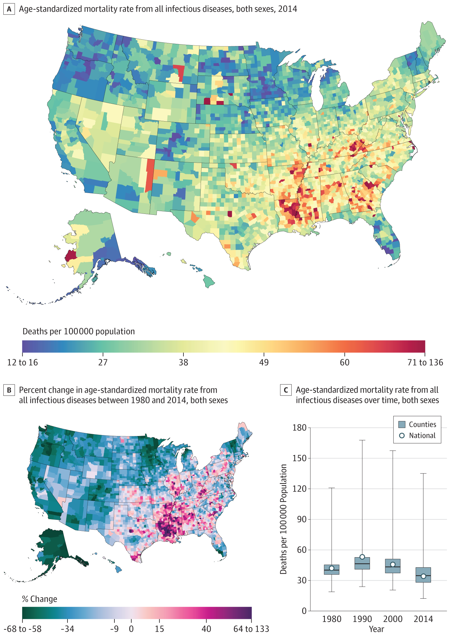
Even in the United States …
Between 1980 and 2014, infectious diseases have killed over 4 million people in the U.S.
Bcheraoui et al., 2018
While I write this talk, over 180,000 people in the U.S. have died from COVID-19.
Our World in Data, 2020
Notes:
Between 1980 and 2014, infectious diseases have killed over 4 million people in the U.S. While I write this talk, over 180,000 people in the U.S. have died from COVID-19.

Slide 25
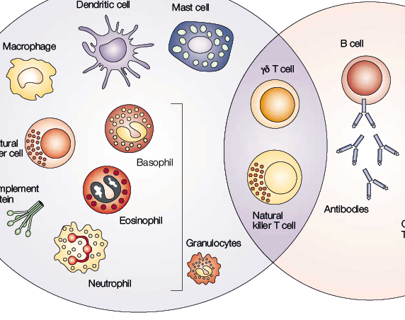
The immune system detects, deflects, and eliminates invading pathogens
Notes:
So it is not surprising that humans have, over evolutionary time, developed sophisticated physical machinery—an immune system—for identifying invasive pathogens and eliminating them.

Slide 26

The immune system also costs valuable energy that could be used elsewhere
Notes:
Of course, the immune system costs valuable energy, so completely ignoring harmful pathogens until they enter the body wastes energy that could be used for other fitness-enhancing activities.

Slide 27
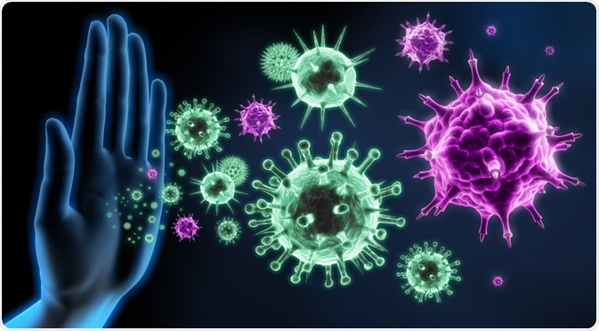
The behavioral immune system
A suite of psychological and behavioral mechanisms designed to detect the presence of pathogens and engage appropriate cognitive, emotional, and behavioral responses to avoid them
Notes:
To reduce these costs, humans have likely developed psychological and behavioral mechanisms—a behavioral immune system—for identifying and mitigating pathogen infection risks.

Slide 28
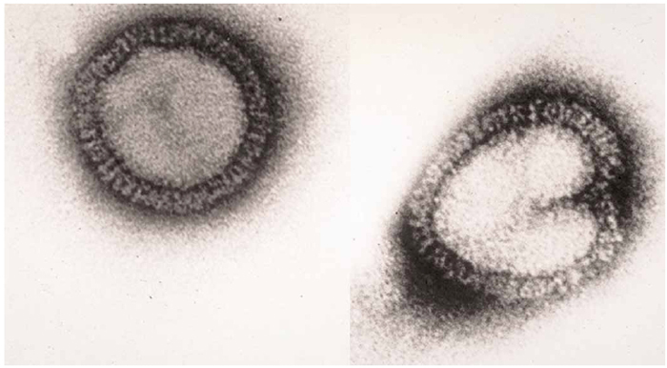
People can’t see pathogenic infections directly
80-120 nanometers
Influenza A
Notes:
The behavioral immune system cannot detect infectious pathogens directly. For example, a particle of the Influenza A virus is approximately 80-120 nanometers in diameter, which is about 20 thousand times smaller than a standard pencil tip. So there’s no way we could detect pathogens just by looking at them.
https://www.nature.com/scitable/content/electron-micrograph-of-influenza-a-virus-particles-26862/

Slide 29
People infer the presence of infection from cues
Measles
Mumps
Yellow Fever
Notes:
So instead of perceiving infectious pathogens directly, people rely on cues that correlate with infection. These cues are often noticeable in appearance because infection can cause rashes, lesions, discoloration, swelling, bleeding, and/or nasal discharge, among other physical changes.

Slide 30
23/25 (92%) of most deadly infectious diseases cause symptoms visible in the face
Measles
Mumps
Yellow Fever
Ryan, Oaten, Stevenson, & Case, 2012; Wolfe, Panosian, & Diamond, 2007
Notes:
For example, many of the most deadly infectious diseases cause visible symptoms in the face.

Slide 31
More facial features look like infection than are actually diagnostic of infection Barrett & Kurzban, 2006; Schaller, 2015; Sperber, 1994
Looks Infected
Is Infected
Notes:
Of course, there are many more facial features that look like infectious disease than are actually diagnostic of infectious disease.

Slide 32
Wide variability in infectious disease symptoms (and look-alikes) Detection errors are inevitable
Haselton et al., 2015; Haselton & Buss, 2000; Haselton & Nettle, 2006; McKay & Efferson, 2010; Nesse, 2005
Notes:
There is variability in diseases and in symptoms. Diseases change and evolve. There is variability in what looks like disease. Thus, facial features are imperfect diagnostic cue for infection. If you rely on only these kinds of cues, errors are inevitable.

Slide 33
False negative errors are more costly than false positive errors
Truly infected
Truly benign
Treat as infected
True Positive | False Positive
False Negative | True Negative
Treat as benign
Notes:
But not all kinds of errors come with the same costs. Failure to identify a dangerous pathogen’s presence (e.g., mistaking swelling from deadly Diphtheria as benign) is far costlier to fitness than mistakenly inferring a parasitic threat that is not there (e.g., mistaking a birthmark as an infectious rash).

Slide 34
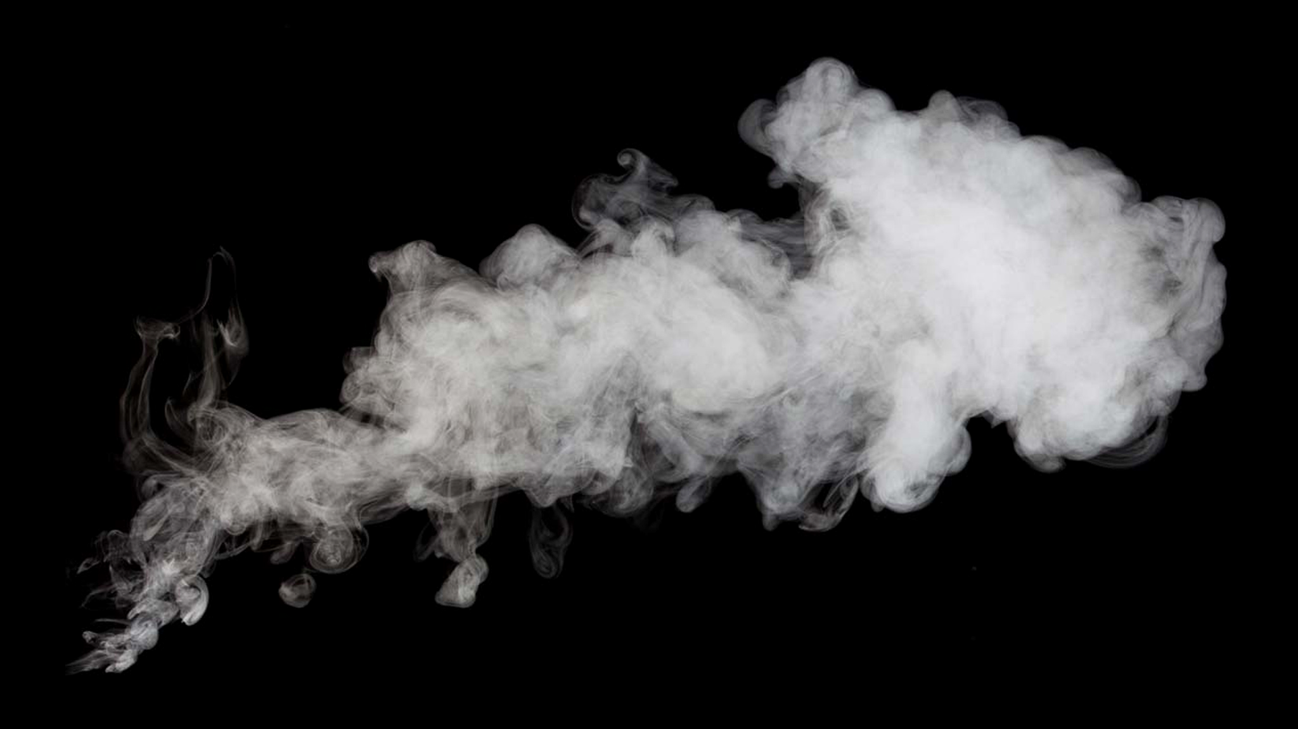
Natural selection could have favored a cognitive bias toward over-perceiving pathogen threats in anomalous cues
Haselton et al., 2015; Haselton & Buss, 2000; Haselton & Nettle, 2006; McKay & Efferson, 2010; Nesse, 2005
Notes:
One solution to this problem is to allow for bias in favor of the less costly error, like how smoke-detectors sound alarms even when there is no fire. When it comes to detecting pathogens, natural selection could favor a cognitive bias that reduces fitness costs by over-perceiving pathogen threats in anomalous cues.

Slide 35
Infection concerns may partly explain stigma directed toward some groups
Obesity
Port-wine stain birthmarks
Old Age
Park, Schaller, & Crandall, 2007
Ryan, Oaten, Stevenson, & Case, 2012
Duncan & Schaller, 2009
Notes:
Researchers who study pathogen avoidance psychology have used this adaptive over-perception to partly explain stigma directed toward people with anomalous yet benign facial features such as obesity, port-wine stain birthmarks, strabismus (i.e., crossed-eyes), old age, and physical disabilities.

Slide 36
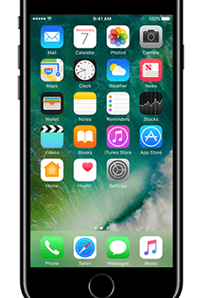
Researcher Assumptions
The behavioral immune system comprises functional mental modules
It comprises cognitive mechanisms with specialized functions with restricted inputs
Barrett, 2012; Barrett & Kurzban, 2006; Schaller, 2016; Sperber, 1994; Sperber & Hirschfeld, 2004
Notes:
To understand the behavioral immune system’s tendency to perceive infection in non-infectious features, researchers in this area assume that the behavioral immune system is a functional module of the mind—it comprises cognitive mechanisms with specialized functions with restricted inputs (Barrett, 2012; Barrett & Kurzban, 2006; Schaller, 2016; Sperber, 1994; Sperber & Hirschfeld, 2004).

Slide 37

One or many cognitive mechanisms of the behavioral immune system function to detect pathogens
Notes:
In the context of pathogen threat, one or many mechanisms of the behavioral immune system function to detect pathogens.

Slide 38
Disease Detection Inputs Proper vs. Actual
Actual
Proper Domain. Set of inputs the module was designed by natural selection to process
Actual Domain. Broader set of inputs the module is able to process
Proper
Barrett, 2012; Barrett & Kurzban, 2006; Schaller, 2016; Sperber, 1994; Sperber & Hirschfeld, 2004
Notes:
To detect pathogens, behavioral immune system processes inputs reflecting true signs of infection: the proper domain. These are the cues the behavioral immune system evolved to process, such as infectious rashes and pox. And because these cues share perceptual properties with many others, the behavioral immune system is able to process a broader set of cues: the actual domain, which includes infectious rashes and pox but also acne and burn scars.

Slide 39
The behavioral immune system should react to true infection cues
Diphtheria
Smallpox
Yellow Fever
Notes:
So, theoretically, the behavioral immune system should react to true infection cues …

Slide 40
The behavioral immune system should react to cues that resemble true infection cues
Acne
Acute liver failure
Obesity
Notes:
And it should also react to false infection cues if such false infection cues share perceptual properties of true infection cues.

Slide 41
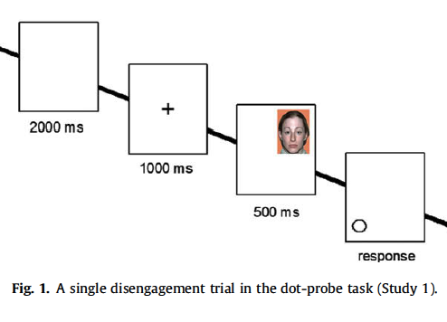
Ackerman et al., 2009, JESP
Randomly assigned to view slide-shows:
Pathogen Threat Condition: dirty sponge, a sneezing person
Control Condition: public buildings
Completed visual attention task for Disfigured Faces vs. Typical Faces
Notes:
Researchers have tested this over-perception hypothesis using a variety of methods. For example, in one study, Ackerman et al. randomly assigned participants to watch either a slideshow of pathogenic objects and people like dirty sponges and sneezing or a slideshow that depicted pathogen-irrelevant objects like public buildings. After the slideshow, they completed a visual attention task (the dot-probe) which measured how long it took participants to pull their visual attention away from disfigured vs. typical faces.

Slide 42
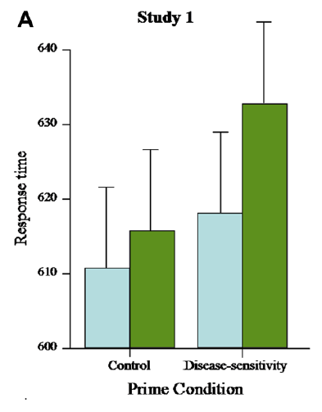
People who watched the pathogen threat slideshow took longer to pull away visual attention from disfigured faces
Ackerman et al., 2009, JESP
Notes:
They found that People who watched the pathogen threat slideshow took longer to pull away visual attention from disfigured faces. This suggests people were attending more to anomalous yet benign facial features when pathogen infection was salient as if those features indicated infection risk.

Slide 43
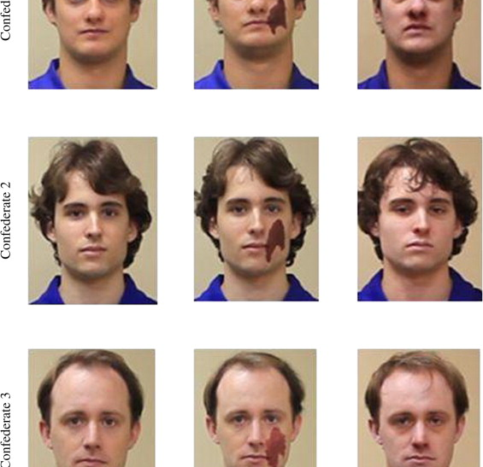
Ryan et al., 2012, EHB
Confederates were videotaped touching a variety of props to their hands, heads, faces, and mouths (e.g., towel, harmonica, snorkel mask)
Confederates appeared healthy, with a port-wine stain birthmark, or with the Flu
Participants were asked to watch videos and imitate the confederates by touching the same objects
Measured imitation behavior, disgust expressions, and disgust behavior
Notes:
In another study, Ryan et al. videotaped confederates touching a variety of props. Some confederates appeared healthy, others were made to look like they had the flu, and others had a port-wine stain birthmark. Participants then watched these videos and were asked to imitate the confederates. The researchers coded videos of the participants disgust expressions, disgust behavior, and touching behavior.

Slide 44
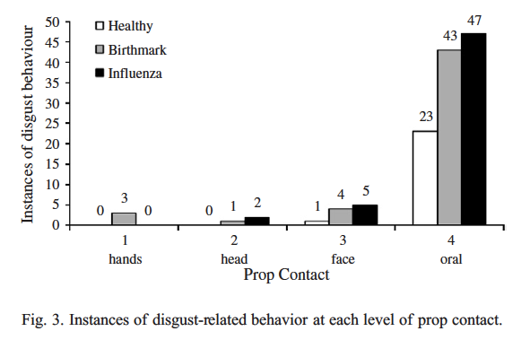
People acted like port-wine stain birthmarks were infectious
Ryan et al., 2012, EHB
Notes:
People were more disgusted by and were less willing to touch objects that had been touched by people with visible cues of influenza compared to the same objects that had been touched by visibly healthy targets (Ryan et al., 2012). People also expressed more disgust by and less willingness to touch those objects when the target people bore non-infectious facial blotches, suggesting participants perceived features that merely resembled infection cues as if they were true indicators; that perception made them avoid touching objects that had been “contaminated” through physical contact.

Slide 45
Park, Schaller, & Crandall, 2007, EHB
Randomly assigned to view slideshows:
Pathogen Threat Condition: germs, infections, pathogen prevalence
Accident Threat Condition: bathtub electrocution
Work Ethic Condition: hard work, “no pain, no gain”
Completed Fat-Disease Implicit Association Tests
Quickly categorized words as related to disease or health and faces as fat or thin
Notes:
As one last example, Park, Schaller, and Crandall randomly assigned participants to watch one of three slideshows: pathogen threat, accident threat, or work ethic. And then participants completed an Implicit Association Test in which they quickly categorized words as related to disease or health and faces as fat or thin.

Slide 46
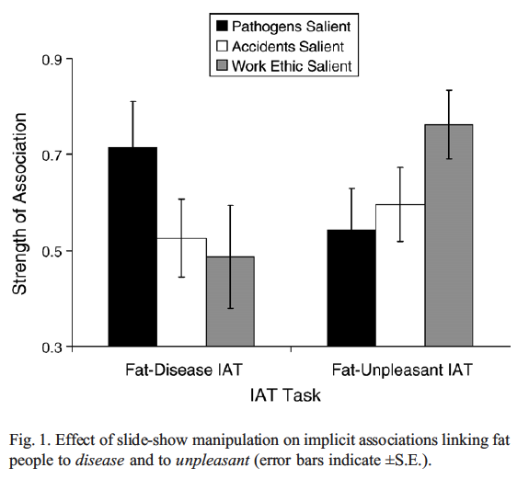
People who watched the pathogen threat slideshow recorded stronger negative associations with obese targets
Park, Schaller, & Crandall, 2007, EHB
Notes:
They found people for whom pathogen threat was salient recorded stronger automatic negative associations with obese targets than people in a control condition (Park et al., 2007)

Slide 47

Results support the hypothesis that people misperceive infection risk in objectively benign features that resemble infection cues
Notes:
Altogether, these results support the hypothesis that people misperceive infection risk in benign features that share perceptual properties with true infection indicators (e.g., rashes, swelling).

Slide 48
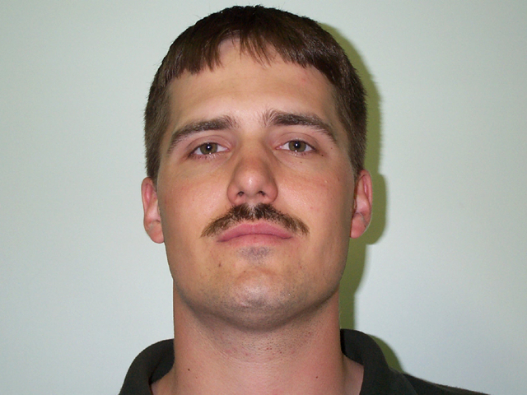
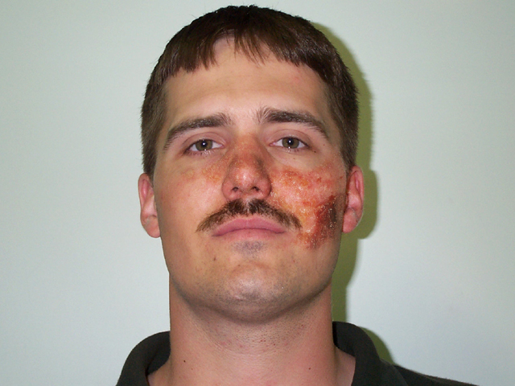
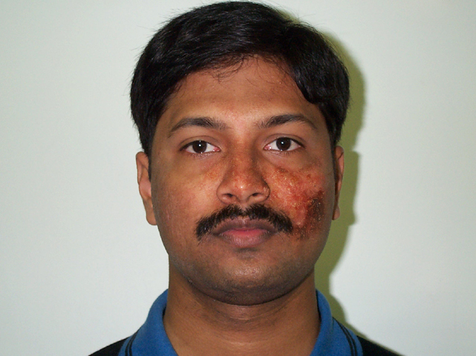

Is “foreign appearance” perceived in ethnic out-groups an infection cue?
Notes:
Researchers have extended this over-perception hypothesis to include cues that less plausibly resemble true infection indicators but nonetheless could be associated with harmful pathogens. The most prominent example is foreign appearance perceived in ethnic outgroups.

Slide 49
Evidence suggests people more concerned about pathogens report stronger negative attitudes toward ethnic outgroups
Aarøe et al., 2017; Faulkner et al., 2004; Huang et al., 2011; Navarrete & Fessler, 2006; Schaller & Neuberg, 2012
Notes:
Evidence suggests people more concerned about pathogens report stronger negative attitudes toward ethnic outgroups

Slide 50
Adaptation-for-Outgroups Hypothesis
Individuals from ethnic out-groups may harbor pathogens that individuals from the in-group have not developed immunity against
Cues associated with ethnic outgroups may elicit responses that at least indirectly limit exposure to people from these groups
van Leeuwen and Petersen, 2018
Notes:
The standard explanation is that individuals from ethnic outgroups may harbor pathogens that individuals from the ingroup have not developed immunity against, so cues such as skin color and other physical features associated with such ethnic outgroups may elicit psychology and behaviors that at least indirectly limit exposure to individuals from these groups (e.g., negative attitudes, prejudice, hostility, avoidance).

Slide 51
Or people learn and transmit information about pathogen avoidance
The adaptation-for-outgroups hypothesis holds that the behavioral immune system was designed to process foreign appearance as an infection cue
But people may learn to associate ethnic outgroups with harmful pathogens even if objectively they’re not
van Leeuwen and Petersen, 2018
Notes:
Alternatively, the behavioral immune system may include design features for learning and transmitting information about avoiding pathogens, which could include stereotypes and experiences linking ethnic outgroups with infection (Fessler et al., 2015).

Slide 52
van Leeuwen and Petersen, 2018
Randomly assigned Indian or White American participants to look at pictures of Indian or White American people with or without infectious rashes on their face
Participants reported how comfortable they’d be sitting next to the pictured people
Notes:
van Leeuwen and Petersen designed a study to test the adaptation for outgroups hypothesis. They randomly assigned Indian or White American participants to look at pictures of Indian or White American people with or without infectious rashes on their face. Participants reported how comfortable they’d be sitting next to the pictured people.

Slide 53
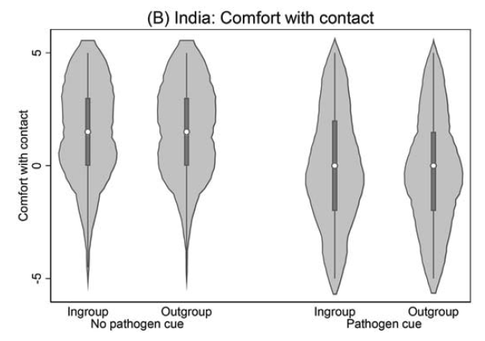
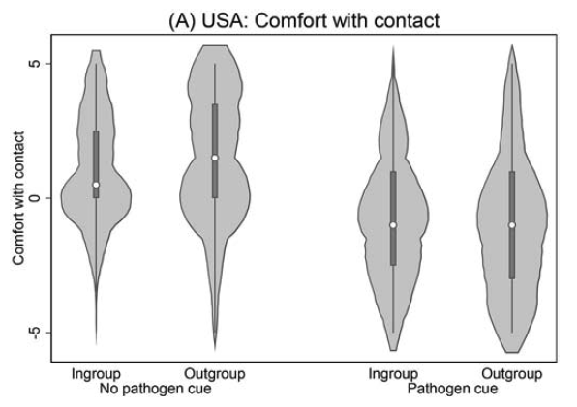
Both Indian and White participants felt less comfortable sitting next to a person with the pathogen cue regardless of in/outgroup status
van Leeuwen and Petersen, 2018
Notes:
They found evidence that people are uncomfortable sitting next to people with an pathogen cue on their face but they did not find support for the adaptation for outgroups hypothesis.

Slide 54
Take these with you
The behavioral immune system reacts to cues that correlate with infection
Such cues include objective infection cues as well cues that look like them
Some results suggests people overperceive infection in benign cues that superficially resemble infection cues
Notes:
OK, I have some takeways for you. First, the behavioral immune system reacts to cues that correlate with infection. Such cues include objective infection cues as well cues that look like them. Some results suggests people overperceive infection in benign cues that superficially resemble infection cues.

Slide 55

Chapter 2. Differences in infection cue strength
Notes:
The next two chapters are empirical chapters, which means I’ll present results from studies I ran. In this chapter, I expand on the over-perception hypothesis and investigate whether some cues are more strongly associated with infection than others.

Slide 56
The behavioral immune system
Comprises functional mental modules designed to detect and mitigate infection risks
Proper domain: true infection cues
Actual domain: true infection cues + cues that resemble them
Some evidence supports hypothesis people over-perceive infection in superficially anomalous, objectively benign cues
Notes:
As a quick recap, the behavioral immune system is theorized to comprise functional mental modules designed to detect and mitigate infection risks. These modules evolved to process true infection cues. These are called proper domain cues. As a by-product of their design, these functional modules are also able to process cues that resemble true infection cues. The set of cues that diagnose infection and the cues that look like them constitute the actual domain of the behavioral immune system. Empirically, some evidence supports the hypothesis that people over-perceive infection in superficially anomalous yet objectively benign cues.

Slide 57

Should some cues elicit stronger immune responses than others?
Notes:
Though these findings provide evidence for an effect of anomalous cues on behavioral immune responses, it is at least unclear from current theory whether the behavioral immune system should treat these cues and other benign, anomalous cues as equally indicative of infection risk. One might expect this system to discriminate between anomalous, benign facial features (e.g., more looking, disgust, avoidance) if some benign features closely resemble highly diagnostic symptoms more than others.

Slide 58
Facial rashes correlate with a large variety of fitness reducing infections Drage, 1999
Notes:
On the one hand, if some features are highly diagnostic—they strongly distinguish between infected and non-infected individuals—then those features warrant uninhibited behavioral immune responses. For example, facial rashes are associated with a large variety of fitness reducing infections (e.g., Drage, 1999).

Slide 59
Obesity has been linked to some infections and may reduce vaccine efficacy Coetzee et al., 2009; Falagas & Kompoti, 2006; Mancuso, 2013; Whigham et al., 2006
Notes:
On the other hand, if some features are poorly diagnostic, the behavioral immune system could mute its responses to them so people can explore fitness enhancing social interactions with people presenting with such features. For example, obesity has been linked to some infections and might weaken the efficacy of vaccines (Coetzee et al., 2009; Falagas & Kompoti, 2006; Mancuso, 2013; Whigham et al., 2006), …

Slide 60
But many people meet criteria for obesity and have no infections, and selection pressures on obesity are unclear Pontzer et al., 2012
Notes:
but many more people meet criteria for obesity but harbor no infection. Moreover, obesity is a relatively modern physical anomaly that may not be under strong selection pressure (Pontzer et al., 2012), making it susceptible to over perception from the behavioral immune system.

Slide 61
Rashes probably better diagnose infection than obesity
Notes:
I think it’s safe to assume rashes probably better diagnose infection than obesity.

Slide 62
The behavioral immune system reacts more strongly to diagnostic, proper domain cues like rashes
Infections are costly
Stronger diagnosticity means less uncertainty
Notes:
The behavioral immune system should be more sensitive to them because, well, infections are costly and stronger diagnosticity means less uncertainty.

Slide 63

Hypothesis
The behavioral immune system reacts more strongly to cues that resemble proper domain cues
People will more strongly associate infectious concepts with benign, rash-looking birthmarks than with obesity
Notes:
My prediction is simple. The behavioral immune system reacts more strongly to cues that resemble proper domain cues. I’ll operationalize this as people will more strongly associate infectious concepts with benign, rash-looking birthmarks than with obesity.

Slide 64
Stronger association with infection ≅ more strongly perceived as infectious
Notes:
To be clear, I’m operationalizing immune responses with strength of association.

Slide 65
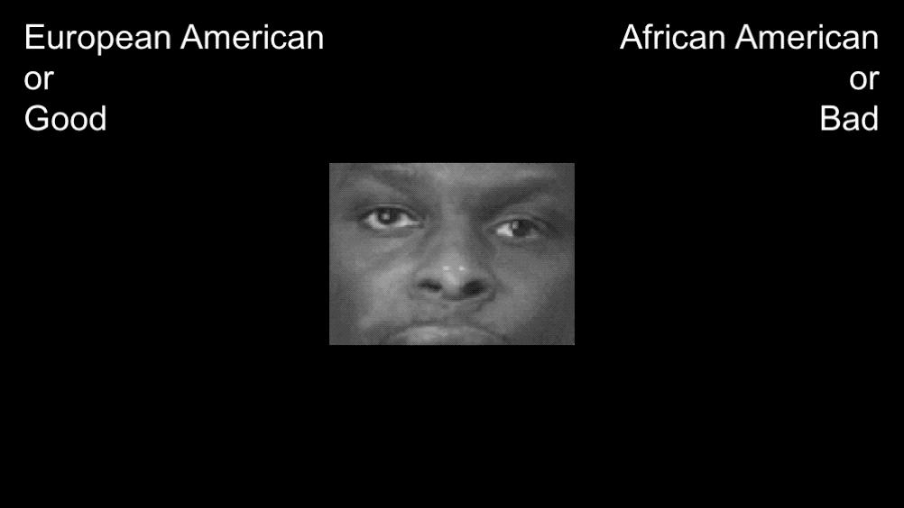
All studies use the Implicit association test
Example. Race IAT
Classification task measures strength of automatic associations Greenwald, Nosek, & Banaji, 2003
Classification response keys change during the task (e.g., African American = Good/Bad)
Notes:
All studies use the implicit association test, which is a classification task used to estimate the strength of automatic association between concepts. The trick is that response keys for target categories change which concepts they’re paired with, and the difference in reaction time associated with the change is supposed to index association strength (faster reaction time = stronger association). For example, in the Race IAT, during some trials African Americans are associated with good concepts and during other trials they’re associated with bad concepts.

Slide 66
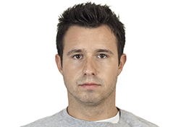
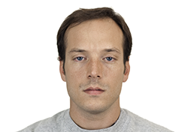
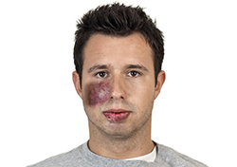
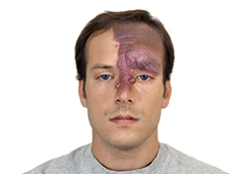
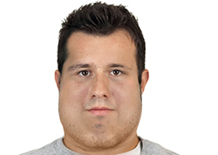
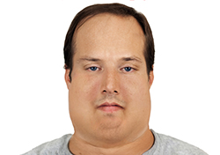
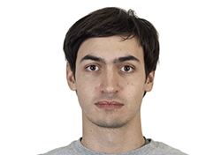
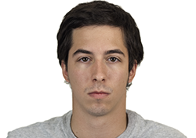
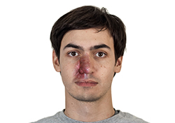
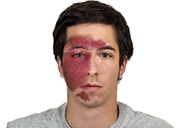
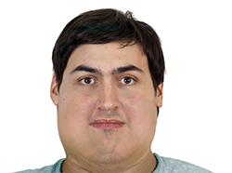
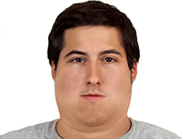
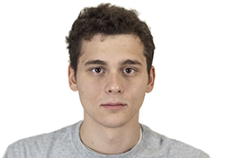
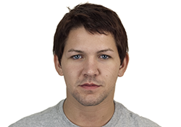
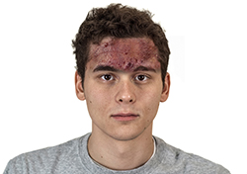
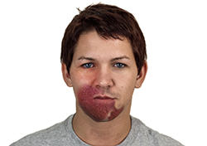
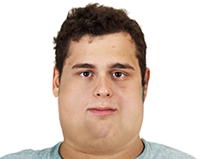







Original
Disfigured
Obese
Stimuli adapted from the Chicago Face Database
Ma, Correll, & Wittenbrink, 2015
Notes:
But in these studies we we focused on anomalous cues, not race. All studies use custom anomalous feature stimuli adapted from the Chicago face database.

Slide 67
What are the key features of each study?
Study 1
(Compare each cue to Average)
Study 2
(Directly compare cues)
Study 3
(Test alternative explanations)
AVERAGE
OR
OBESE
AVERAGE
OR
DISFIGURED
OBESE
OR
DISFIGURED
OBESE
OR
BURN SCAR
OBESE
OR
DISFIGURED
INFECTIOUS
OR
HARMLESS
INFECTIOUS
OR
HARMLESS
INFECTIOUS
OR
HARMLESS
INFECTIOUS
OR
HARMLESS
LAZY
OR
HARMLESS
Notes:
The first study was designed to mimic past research; they test whether anomalous feature are more associated with infectious concepts compared to average faces
The second study directly test our hypotheses by including both anomalous feature in the same task
The last studies test alternative explanations about how participants interpret the stimuli and also general negativity

Slide 68
Sample Characteristics
Study | Participants | Age | Women | White
1 | 283 | 18.90 (2.16) | 167 (59%) | 171 (60%)
2 | 256 | 18.90 (1.11) | 152 (59%) | 165 (65%)
3 & 4 | 134 | 18.84 (0.90) | 87 (65%) | 99 (74%)
Notes:
I recruited participants from the UM Psychology Subject Pool.

Slide 69
Study 1 Goals
Participants categorize faces with or without anomalous cues
Categorize Infectious or Harmless words
Compare Obese and Disfigured strengths of association with Infectious concepts
Notes:
Here are the goals for Study 1. Participants categorize faces with or without anomalous cues. They categorize Infectious or Harmless words. In my analysis, I compare Obese and Disfigured strengths of association with Infectious concepts.

Slide 70

Anomalous Feature IAT
Notes:
Here's a good representation of what participants saw. They had to categorize the words and pictures in the middle as quickly as they could.

Slide 71
FASTER reaction time = stronger association
Notes:
Before I present results, I want to prepare you for the plots. Remember that faster reaction times indicate stronger associations.

Slide 72

People more strongly associated infection with anomalous cues, especially disfigurement
Notes:
People more strongly associated infection with anomalous cues, especially disfigurement.

Slide 73

Average Difference =
### milliseconds, 95% CI [###, ###]
Average Difference =
### milliseconds, 95% CI [###, ###]
Notes:
The bars represent average reaction time predicted from a fancy regression model. Each panel represents reaction time to categorize one of the two randomly assigned anomalous cues, disfigurement on the right and obesity on the left. People more strongly associated infectious words with anomalous faces than with average faces. But the effect of the disfigurement cue was larger. These are raw effect sizes in milliseconds. To give you a sense of scale, an eyeblink is about 100 milliseconds.

Slide 74

Average Difference =
### milliseconds, 95% CI [###, ###]
Average Difference =
### milliseconds, 95% CI [###, ###]
Notes:
These plots are the same expect now the plots represent the distributions of the raw sample data. You might be wondering why it's so hard to see the difference. I'm showing you this so you can see how noisy IAT data can be. But, like you saw in the bar plots, there is a small but strongly non-zero interaction.

Slide 75
Study 1 Takeaways
Anomalous faces were automatically associated with Infectious concepts
Compared to Obese faces, Disfigured faces were more strongly associated with Infectious concepts
Notes:
Here are the takeways. Anomalous faces were automatically associated with Infectious concepts. Compared to Obese faces, Disfigured faces were more strongly associated with Infectious concepts

Slide 76
Study 2 Goals
Have participants categorize both Obese and Disfigured faces in the same IAT
Participants directly experience key comparison
Notes:
Have participants categorize both Obese and Disfigured faces in the same IAT. Participants directly experience key comparison

Slide 77

Combined Anomalous Feature IAT
Notes:
This is a good representation of what participants saw. Notice that participants categorized obese and disfigured faces in the same task.

Slide 78
People more strongly associated infectious concepts with disfigurement than with obesity

Slide 79

Average Difference = 140 milliseconds, 95% CI [###, ###]
Notes:
The average difference was a little longer than an eye blink.

Slide 80
Study 2 Takeaways
Participants categorized both Obese and Disfigured faces
Like in Study 1, compared to Obese faces, Disfigured targets were more strongly associated with Infectious concepts

Slide 81

Study 3A and 3B Questions
Do participants believe Disfigured targets are truly benign (not caused by infections)?
Do participants associate Disfigured targets with all negative categories?
Notes:
We designed study 3 to test alternative explanations that stem from two questions
Do participants believe Disfigured targets are truly benign (not caused by infections)?
Do participants associate Disfigured targets with all negative categories?

Slide 82
Study 3A and 3B goals
3A. Replace Disfigured category with Burn Scar category and tell participants scars are benign (not infectious)
3B. Replace Infectious category with Lazy category
van Leeuwen, Hunt, & Park, 2015
Notes:
We Replace Disfigured category with Burn Scar category and tell participants scars are benign (not infectious)
And we replaced Infectious category with Lazy category
lazy = poor cooperation partner
Poor cooperation partners with low self-control

Slide 83
Anomalous Feature IAT
Obese
or
Harmless
Disfigured
or
Lazy
Obese
or
Harmless
Burn Scar
or
Infectious
Notes:
To give you a sense of what’s different, see that we replaced disfigured with burn scar in one version and we replaced infectious with lazy in another version.

Slide 84
People more strongly associated infectious concepts with burn scars than with obesity

Slide 85

Average Difference = ### milliseconds, 95% CI [###, ###]

Slide 86

People more strongly associated lazy concepts with obesity than with disfigurement

Slide 87

Average Difference = ### milliseconds, 95% CI [###, ###]

Slide 88
Study 3 Takeaways
Like “Disfigured” faces in Studies 1 & 2, compared to Obese faces, Burn Scar faces were more strongly associated with Infectious concepts
Compared to “Disfigured” faces, Obese faces were more strongly associated with Lazy concepts

Slide 89
Empirical Takeaways
Studies 1 & 2. Obese and “Disfigured” associated with Infectious concepts, but “Disfigured” more strongly associated
Studies 3A & 3B. Effects not easily explained by misinterpreting “Disfigured” stimuli or by general negative associations

Slide 90
Methods Takeaways
Novel face and word stimuli
Statistical analyses use all data collected from IAT tasks
Tested focal contrast two different ways

Slide 91
Theoretical Takeaways
Neither facial disfigurement nor obesity diagnose infection
Facial disfigurement may seem to resembles an infection indicator that is more diagnostic of infection than the indicator obesity resembles

Slide 92

Chapter 3. Mental representations of infected others
Notes:
OK, that’s it for chapter 2. In chapter 3, I use a functional threat management framework to make the case for why we could expect people to have unique mental representations of infected others. And then I use a variety methods to estimate these representations.

Slide 93

What does an infected person look like?
Notes:
What does an infected person look like? In your mind, you might picture someone pale and weak, someone with a runny nose and watery eyes, or someone with facial rashes and sores. Whichever features appeared in your mind’s eye, where did they come from? Many of you probably imagined features based on intuition, experience, and stereotypes. Or maybe you imagined some of the features I’ve been talking about for the last 20 minutes or so.

Slide 94

Mental representations partly depend on expectations
Notes:
Put differently, mental representations depend partly on expectations. Researchers have representations. Normal people who end up in studies have expectations. What we expect affects what we imagine, what we study, and how we study it.

Slide 95
Infected People Features?
Disfigured or Asymmetrical
Obese
Old
Unhealthy
Rashes or blotchiness
Crossed-eyes
Notes:
During my first semester in graduate school, Josh and I were interested in how people mentally represented infected people. Based on the behavioral immune system literature, we expected them to have at least some of the features I’ve been talking to you about for the past 20 minutes.

Slide 96
Threat Specificity
Different threats entail different psychological and behavioral solutions
Notes:
In other words, we expected people to mentally represent threating others features that are specific to the threat they pose. The idea is that people need to be able to recognize and imagine what specific threats look like because different threats require different psychological and behavioral solutions. People process and react to sick individuals differently than they do violent individuals. This is, in part, because effectively avoiding infection requires different behaviors than avoiding violence.

Slide 97

Wash your hands to avoid getting sick
Notes:
For example, one washes their hands to avoid getting sick when interacting with someone who coughs and sneezes, …

Slide 98

Raise your hands to avoid injury if someone brandishes a weapon
Notes:
whereas one raises their hands to avoid injury when interacting with someone who brandishes a weapon.

Slide 99


Natural selection has favored mental systems that enable people to perceive, feel, think, and behave in ways to reduce threats in-particular rather than threats in-general
Barrett, 2012; Cosmides & Tooby, 1994; Holbrook & Fessler, 2015; Neuberg et al., 2011; Tooby & Cosmides, 1992
Notes:
From what I refer to as the functional threat management perspective, natural selection has favored mental systems that enable people to perceive, feel, think, and behave in ways to reduce threats in particular rather than threats in general (Barrett, 2012; Cosmides & Tooby, 1994; Holbrook & Fessler, 2015; Neuberg et al., 2011; Tooby & Cosmides, 1992). This perspective does not imply that specific threats always elicit specific responses (e.g., most threats elicit anxiety due to shared processing mechanisms), but a fully general response to all threats would be less efficient than responses targeting the unique affordances of each threat.

Slide 100
Evidence suggests people exhibit functional responses to specific threat cues Neuberg et al., 2011
Notes:
Consistent with this perspective, a growing body of evidence suggests people exhibit functional responses to specific threat cues. I’ve talked to you a ton about pathogen threats, so I shift to violence threats.

Slide 101

Holbrook et al., 2014, Emotion
Randomly assigned to evaluate people holding harmless objects or potential weapons
Rated trait and state anger, fear, and disgust
Notes:
Holbrook et al. randomly assigned participants to evaluate people who were either holding harmless objects or objects that could plausibly be used as weapons. They rated the targets’ state and trait emotions like anger, fear, and disgust.

Slide 102

People estimated greater state and trait anger in men holding household items that could be used as weapons
Holbrook et al., 2014, Emotion
Notes:
They found that people estimated greater state and trait anger in men holding household items that could be used as weapons (e.g., garden sheers) compared with men holding objects that are less plausible as weapons (e.g., a watering can) (Holbrook et al., 2014). Thus, a threat-specific cue elicited a functional response: People perceived men holding plausible weapons as more prone to anger.

Slide 103

Other research has linked aggression threat to formidable physical features such as size and weight Fessler et al., 2012
Notes:
Other research has linked aggression threat to formidable physical features such as size and weight Fessler et al., 2012. So, theoretically, people process threatening others in threat-specific ways. Some studies on pathogen threat and violence threat support this hypothesis.

Slide 104
Researchers often test one anomalous facial feature at a time Feature present vs. absent
Disfigured vs. Normal Ackerman, et al., 2009
Obese vs. Normal Miller & Maner, 2012
Old vs. Young Duncan & Schaller, 2009
Notes:
Many of the studies in these functional threat management literatures are limited in at least two key ways. First, researchers pick cues to represent threat cues and they often compare them to neutral or cue absent conditions. So results based on a few cues employed across a handful of studies may not generalize to a more representative universe of cues.

Slide 105



People may mentally represent threats with different cues than those they react to (and vice versa)
Notes:
Second, all the studies test hypotheses about how people react to threat cues. It’s possible that reactions to threat cues mean that people represent threats in their minds with those cues, but it’s also possible that people represent threats with different cues than the one they react to.

Slide 106

People rate younger faces more trustworthy than older faces Zebrowitz & Franklin Jr, 2014
But do you think of trustworthy people as young?
Notes:
As one example, there’s a robust finding that people rate younger adults more trustworthy than older adults. If you flip this around and ask people to list traits of trustworthy people or imagine what a trustworthy person looks like, they might not list young or imagine young people. So reactions to stimuli don’t necessarily tell you how people represent a social category.

Slide 107
Our Expectations
Threat representations will appear with threat-specific cues
Threat representations will posses some unexpected features
Notes:
So, to sum all this up, based on the functional threat management literature, we expected infected mental representations to be threat specific. And we had some good reasons to expect mental representations tell us something a little different than studies that measure reactions to threat stimuli.

Slide 108

Threat-Specific Hypothesis
Threat representations will primarily include cues specific to and diagnostic of that threat.
Notes:
We developed two hypotheses for how infected representations could look. The first hypothesis we called the threat-specific hypothesis. The threat-specificity hypothesis predicts that threat representations will primarily include cues specific to and diagnostic of that threat.

Slide 109

Threat-Combination Hypothesis
Threat representations will include a combination of threat cues common across multiple types of threats
Notes:
The second hypothesis—what I label the threat-combination hypothesis—is the natural complement to the first. The threat-combination hypothesis predicts threat representations will include a combination of threat cues common across multiple types of threats. In sum, threat-specificity predicts representations will appear to pose one kind of threat (e.g., strong infection-related cues), whereas threat-combination predicts representations will appear to pose 2 or more kinds of threat (e.g., equally strong infection- and violence-related cues).

Slide 110
How did I measure mental representations?
Study 1. List visible traits associated with infected people
Study 2. Draw pictures of infected people
Studies 3-5. Select images that look like infected people
Notes:
I measured mental representations using three methods: I had participants list traits, draw pictures, and select images in what’s called a reverse correlation task.

Slide 111

How did I measure features of mental representations?
Trait listing. Counted the most frequent words used to describe traits
Drawings. Had independent participants rate subjective features they saw in the drawings
Image classification. Averaged the images selected and had independent participants rate subjective features they saw in the images
Notes:
I measured features in a few different ways. I counted the most frequent words used to describe traits; I had independent participants rate subjective features they saw in drawings; and for the image classification task, I averaged the images and then for those too I had independent participants rate subjective features they saw in the averaged images.

Slide 112
Sample Characteristics
Study | Source | Role | N | Excluded | Age | Women | White
1 | Undergraduate | Lister | 117 | 0 (0%) | 18.84 (0.81) | 49 (42%) | 64 (55%)
2 | Undergraduate | Artist | 147 | 0 (0%) | 19.00 (0.90) | 97 (66%) | 90 (61%)
2 | MTurk | Rater | 129 | 14 (10%) | 36.55 (11.74) | 76 (59%) | 99 (77%)
3 | Undergraduate | Chooser | 94 | 2 (2%) | 19.13 (1.70) | 45 (48%) | 72 (77%)
3 | MTurk | Rater | 272 | 18 (6%) | 35.68 (11.07) | 139 (51%) | 197 (72%)
4 | Undergraduate | Chooser | 205 | 0 (0%) | 18.75 (0.92) | 153 (75%) | 180 (88%)
4 | MTurk | Rater | 464 | 50 (10%) | 37.97 (12.27) | 242 (52%) | 301 (65%)
5 | MTurk | Chooser | 200 | 44 (18%) | 36.94 (11.38) | 92 (46%) | 149 (75%)
5 | MTurk | Rater | 505 | 37 (7%) | 35.46 (10.88) | 272 (54%) | 384 (76%)
Notes:
Across five studies, I recruited a lot of participants from the University of Michigan Psychology Subject Pool and Amazon Mechanical Turk.

Slide 113
Study 1 Goals
List visible traits associated with infected people and violent people (as a comparison)
Count the most frequent words used to describe each threat category

Slide 114
Instructions
In this task, we'd like you to imagine two specific kinds of people. Specifically, what do these kinds of people look like? When you imagine either of these kinds of people, what traits can you see these people having?

Slide 115
What does an infected [violent] person look like?
infected: affected or contaminated (a person, organ, wound, etc.) with disease-producing germs or pathogens; capable of causing infection in other people
violent: prone to commit acts of violence; uses physical force intended to hurt, damage, or kill someone or something
Notes:
In random order, participants listed traits for either infected people and then violent people or violent people and then infected people. We gave them these definitions and 10 text boxes

Slide 116

Participants more often listed infection-related traits for infected others than for violent others, and they more often listed violence-related traits for violent others than for infected others.

Slide 117


Slide 118
Study 1 Takeaways
People listed traits of infected and violent people consistent with the threat-specific hypothesis

Slide 119
Study 2 Goals
Draw pictures of infected and violent people (as a comparison)
Recruit independent raters to rate subjective features they see in the drawings

Slide 120
We asked participants to draw both a Germy and a Violent representation (which we defined for them)
Germy Definition. full of germs; germ infested; appearing either sick or contaminated
Violent Definition. prone to commit acts of violence; uses physical force intended to hurt, damage, or kill someone or something

Slide 121
I had raters rate either 5 germy drawings or 5 violent drawings
How clear is this image?
How germy is this person?
How disfigured is this person?
How old is this person?
How heavy is this person?
How oreign is this person?
How atigued is this person?
How healthy is this person?
How violent is this person?
How angry is this person?
How dominant is this person?
How muscular is this person?
How masculine is this person?

Slide 122


Rated Extremely Violent
Rated Extremely Germy

Slide 123

Germy drawings appeared with stronger-looking infection-related features and violent drawings appeared with stronger-looking violence-related features
Notes:
Germy drawings appeared to have some stronger infection-related features (e.g., germy, disfigured, fatigued, unhealthy) than infection-unrelated features (e.g., violent, angry, dominant). For between-category effects, the Germy drawings in Study 2 were rated more germy, more fatigued, and less healthy than the Violent drawings (which were rated more violent, angry, old, and dominant than Germy drawings)

Slide 124


Slide 125
Study 2 Takeaways
People drew pictures of infected and violent people consistent with the threat-specific hypothesis
But there was some overlap in how violent infected drawings looked and how infected violent drawings looked

Slide 126

Study 3, 4, & 5 Goals
Use reverse correlation 2-image forced-choice classification task to estimate mental images of germy, infected, and violent people (for comparison)
Recruit independent raters to rate subjective features they see in the proxy mental images

Slide 127
Experimentally manipulated features vs. Reverse Correlation images
Experimentally manipulated features
Estimate the effect of one or a few features on psychological outcomes
Example. What’s the effect of facial birthmarks on infection judgments?
Reverse Correlation
Randomly vary features and have participants select a category of interest from many pairs of images
Example. What does an infected person look like?
Notes:
I want to take a moment to explain reverse correlation in comparison to a more traditional approach of experimentally manipulating one or a few features. When researchers experimentally manipulate features, they’re interested in the effect of one or a few features on psychological outcomes. For example, what’s the effect of facial birthmarks on infection judgments. Reverse correlation flips the question in away. Instead of holding features constant, reverse correlation procedures randomly vary features and have participants select a category of interest from many stimuli. Researchers use this procedure when they’re interested in questions like what does an infected person look like?

Slide 128

Base image
Notes:
We start with a base face, a gray scale average of all male faces in the Karolinska Face Database (used in prior RCP research)

Slide 129
Random Noise Pattern
Notes:
Create randomly generated noise patterns that will be superimposed on the base face.

Slide 130


Which face looks more [insert trait]?
Base image with
original noise superimposed
Base image with
the negative noise superimposed
Notes:
On the left a random noise pattern has been superimposed onto the base face.
So on the right the negative noise pattern is superimposed on the base face. Basically every dark pixel in the original noise pattern is light in the negative.
So participants will see somewhere between 300 and 700 of they’ll select which face in a given pair looks most like some trait. It cab be whatever you want.

Slide 131
Notes:
During the task, participants first they see a centered fixation cross for 1 second.

Slide 132
Which face looks more infected?
Notes:
Then they make a choice.

Slide 133
Notes:
Then they see another fixation cross.

Slide 134
x 400 Trials
Notes:
Repeat 400 times.

Slide 135



Mental Image = Average of images participants selected
3

Slide 136





Studies 3-5. Germy and Infected Mental Images
Study 3
Study 5
Study 4
Study 4
Study 5

Slide 137
I had raters rate germy, infected, healthy, or violent mental images
How clear is this image?
How germy is this person?
How disfigured is this person?
How old is this person?
How heavy is this person?
How oreign is this person?
How atigued is this person?
How healthy is this person?
How violent is this person?
How angry is this person?
How dominant is this person?
How muscular is this person?
How masculine is this person?

Slide 138
Studies 3-5 Results
Germy and Infected images appeared with a mix of stronger-looking infection–related and violence-related features than Healthy images

Slide 139


Slide 140
Studies 3-5 Results
Violent images appeared with stronger-looking threat features—both infection-related and especially violence-related—than Germy Images

Slide 141


Slide 142
Studies 3-5 Results
Objective pixel-luminance values of the Germy and Infected images correlated more strongly with each other than with those from the Violent images

Slide 143


Slide 144

Study 3, 4, & 5 Takeaways
People generated mental images of germy, infected, healthy, and violent people consistent with the threat-combination hypothesis
Although different threat images appeared with a combination of threatening features, the images themselves were meaningfully distinct

Slide 145

Empirical Takeaways
Studies 1 & 2. People listed traits for and drew pictures of infected and violent people with predominantly threat-specific features
Studies 3-5. People generated mental images of germy, infected, healthy, and violent people with a combination of infection-related and violence-related features

Slide 146

Methods Takeaways
Trait listing and drawings tasks seemed to elicit expectation-driven results
Reverse correlation tasks seemed to elicit less expectation-driven results
Different mental representation methods can yield hard-to-reconcile results

Slide 147

Theoretical Takeaways
People can mentally distinguish between different kinds of threatening others
“Constrained” or “Implicit” or “Automatic” mental representations of threats could be less threat-specific

Slide 148

Almost done

Slide 149

Limitations & Future Directions
WEIRD participant samples
Small stimuli samples
Sociocultural and evolutionary explanations difficult to pull apart
Behavioral immune system researchers should study ontogeny/development of behavioral immune system
Notes:
This research was really fun, and I think it makes some pretty interesting contributions, but it’s limited in important ways. Of course, my participant samples were WEIRD and my stimuli samples were small. That’s probably par for the course for a lot of social psychology, but these are very important limitations nonetheless. Also, I took an evolutionary perspective on these studies, but these data by no means rule out sociocultural explanations. Finally, I want to point out that I think the behavioral immune system literature would benefit from developmental work. We should specify when during development we expect people to develop pathogen avoidance mechanisms.

Slide 150

Dissertation Takeaways
Nesse, 2013, Trends in Ecology & Evolution

Slide 151

Thank you

